Slide 1
Python 101
Python 101
Created by wonderluc

Slide 2
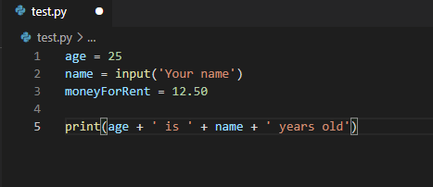
Variables
Age
Name
MoneyForRent
25
“Alex”
12.50

Slide 3
Data types
Text Type
Numeric types
Sequence types
Mapping Type
Set types
Boolean type
Binary Types
str
int float complex
list tuple range
dict
set frozenset
bool
bytes bytearray memoryview

Slide 4
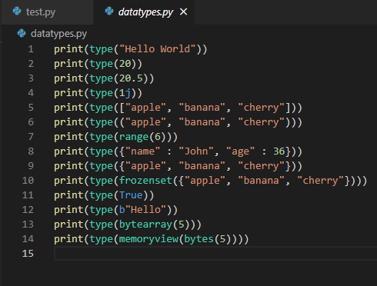
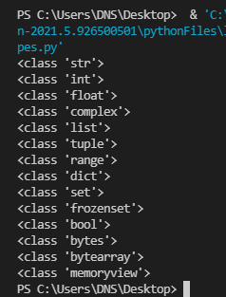

Slide 5
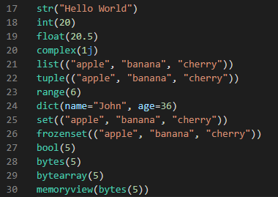
Transform Data Type

Slide 6
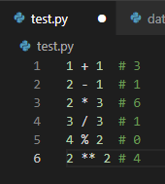
Math Operators
Addition
Subtraction
Multiplication
Division
Modulus
Exponent
It may used as variable assignment +=, -=, **= and other

Slide 7
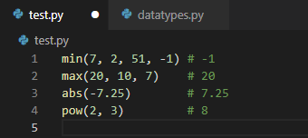
Math Built-in functions
min(numbers[])
max(numbers[])
abs(number)
pow(number, power)

Slide 8

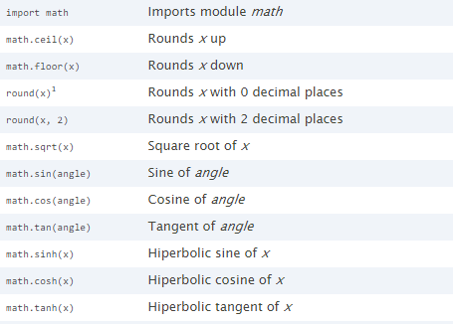
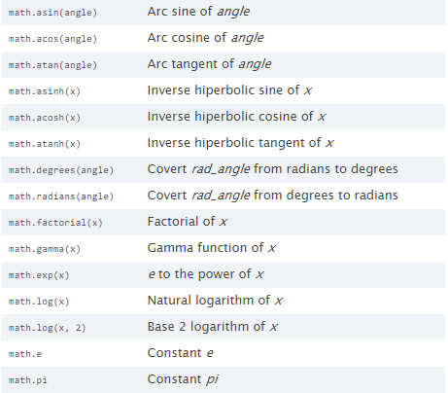
math module
Usage

Slide 9

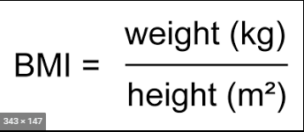
Tasks
Find lowest number among group
7, 10, 9 , 20
-1, 2, 5, -1.5
23532, 35329, 2335, 33
Find square root
User input some number
Program print square root of it
Create BMI program
BMI – body mass index
Its calculates by formula:
Program should return the result of calculation

Slide 10
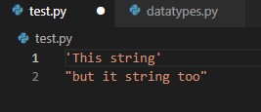
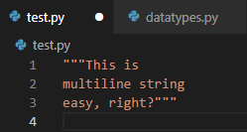
Strings
Syntax
Single line string
Multiline string

Slide 11




Description and abilities
Strings are Arrays
Length of string
len()
Check string
Slicing
Escape Characters
Starts with \
\n , \t, \r , \b , \f, \o, \x

Slide 12
Methods – Easy Transformation
find() Searches the string for a specified value and returns the position of where it was found
capitalize() Converts the first character to upper case
swapcase() Swaps cases, lower case becomes upper case and vice versa
upper() Converts a string into upper case
lower() Converts a string into lower case
count() Returns the number of times a specified value occurs in a string
encode() Returns an encoded version of the string

Slide 13
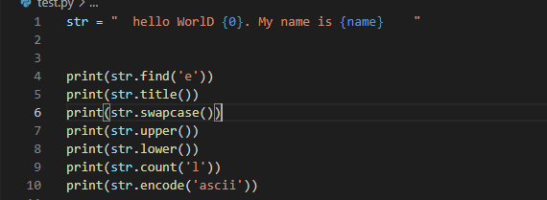
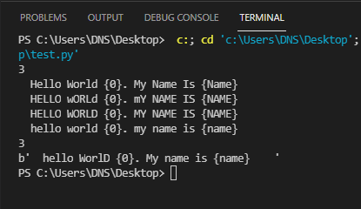

Slide 14
Methods – Transformation
format() Formats specified values in a string
replace() Returns a string where a specified value is replaced with a specified value
join() Joins the elements of an iterable to the end of the string
split() Splits the string at the specified separator, and returns a list
strip() Returns a trimmed version of the string

Slide 15
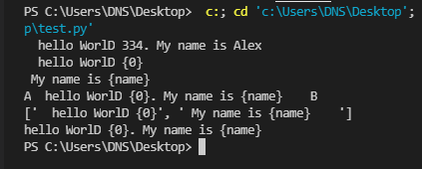
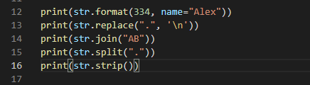

As example of format we may use f-string :

Slide 16
Methods – Checks
isalnum() Returns True if all characters in the string are alphanumeric
isalpha() Returns True if all characters in the string are in the alphabet
isdecimal() Returns True if all characters in the string are decimals
isdigit() Returns True if all characters in the string are digits
isidentifier() Returns True if the string is an identifier
islower() Returns True if all characters in the string are lower case
isnumeric() Returns True if all characters in the string are numeric
isprintable() Returns True if all characters in the string are printable
isspace() Returns True if all characters in the string are whitespaces
istitle() Returns True if the string follows the rules of a title
isupper() Returns True if all characters in the string are upper case

Slide 17
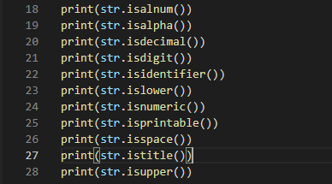
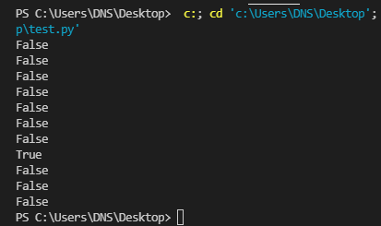

Slide 18
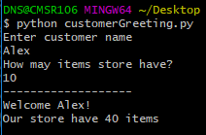
Tasks
Write Customer Greeting program
It should take customers Name and amount of items in store
It should use string method – format
Amount of items calculates on inputted number multiplied by length of Name
It should return Greeting of customer and how many items store have. In two lines

Slide 19
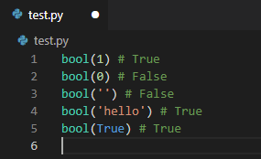
Boolean
Represent one of two values: True or False
Almost any value is evaluated to True if it has some sort of content.
Any string is True, except empty strings.
Any number is True, except 0.
Any list, tuple, set, and dictionary are True, except empty ones.

Slide 20
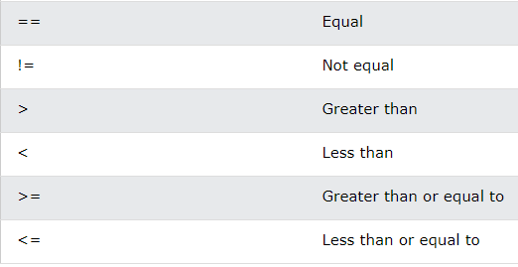
Boolean Operators

Slide 21
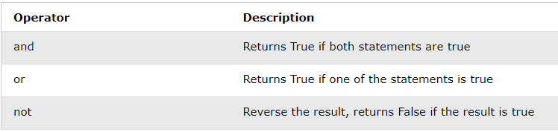
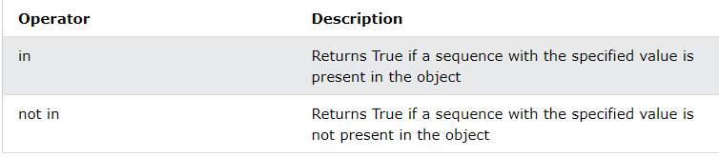
Logical Operators
Membership Operators

Slide 22
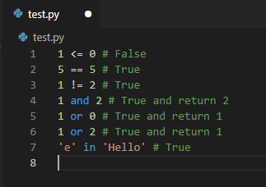

Slide 23



If … Else – Conditions
Most commonly Booleans using in “if statements”
The elif keyword is pythons way of saying "if the previous conditions were not true, then try this condition".
else keyword catches anything which isn't caught by the preceding conditions

Slide 24
Tasks
Rewrite BMI program so it must return status of patient
BMI < 18.5 – underweight
18.5 – 24.9 – normal
25 – 29.9 – overweight
30 – 34.9 – obese
> 35 – extremely obese
Our store should know regular customers! So write individual greetings!
We have 5 regular customers : Ann, Braver, HeadChop, and brothers – Abby and Garry.
Common greeting for NOT regular customer – “Hello! Can I help you?”
For regular customer – “Hello, [CUSTOMER NAME]! Did you want to see new products? ”
Ann prefer when greeting in lowercase except her name
Braver prefer UPPERCASE
Abby and Gary prefer the greeting – “Good boys” , when come together.
The client will tell his name to your program exactly as it is written in the task.

Slide 25
Coffee Break

Slide 26

List
List is a collection( array ) of items with specified index. Like a bookshelf with number for each book.
List items are ordered, changeable, and allow duplicate values.
For take list’s length – len()
If you want take item from list use index like in string.
Index starts with 0

Slide 27


Array(List) Manipulations
Take Item – use index, slice an array or method index()
Change item in array
Add item
Remove item
Concatenate arrays

Slide 28
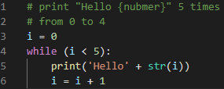
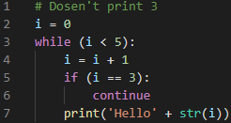
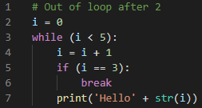
WHILE LOOP
With while loop we can execute a set of commands as long as a condition for while equal true
NOTE! You need to change the condition, or else the loop will continue forever
break \ continue keywords – may use for pass one cycle of loop or end cycle at all
Notice how we change the index increment. Because in the other case it will be an infinite loop after 3

Slide 29
Tasks
Write a loop that prints all elements from given array
[1, ‘two’, ‘tea’, True, [3, 4], ‘end’ ]
Rewrite previous greeting program
It should work until the user enters “out”
All inputs may be in different cases
Abby and Garry gone to other store
HeadChop comfortable with Headchop too

Slide 30



FOR LOOP
A for loop is used for iterating certain time. So maintain it used for iterating over a sequence (like a list)
If you want more control and add some count you may use range(). It’s takes number add represent a range from 0 to number - 1 .
for also have break\ continue keywords

Slide 31
Tasks
Write program to find in given array person by a Name and subtract entered value from his health
Schema of a person – [Name: str, isEnemy: bool, health: int]. It maybe a different order
Once when program start print all persons
If user input “show” command, program should print all persons
All action goes from person like “Alice: had 30 damage”
If health less 0 then print – “{Name} die” and removes from array
If Person not found or already died, then print – “Error, target died or not exist”
User may enter data by different register, but order of it is always same – Name Damage
Program ends when user enters – “out”
If it not enemy – print “Hey! Don’t touch yours friend, wierdo!”
[
['Alice', True, 100],
['Joe', 30, False],
[True, 'Megan', 200],
[50, 'Oliver', False],
[200, True, 'Rassel'],
['Molly', True, 2147000000]
]
Write for loop that add to array items from given array(list) multiplied by 2. Then print new Array
[1, 2, 3, 4, 11, 54, 1099, ‘ yes’]
Use while and for loops for it

Slide 32

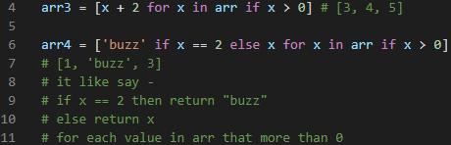

List Comprehension (Generator)
List comprehension offers a shorter syntax when you want to create a new list based on the values of an existing list. Common syntax (or generator) – newlist = [expression for item in iterable if condition == True]
You may filter it, of change value returned value base on conditions
Also you may create a non-array based list with range()

Slide 33


Sort Array
For sort array – use sort() method
sort() used only with same data types in array
Strings sorted by first letter charter code( A – 65 B – 66, a - 97 ). For take charter code use ord(), reverse use chr()

Slide 34



Copy and Join Lists
You cannot copy a list simply by typing list2 = list1, because: list2 will only be a reference to list1, and changes made in list1 will automatically also be made in list2.
There are ways to make a copy, one way is to use the built-in List method copy()
Another way to make a copy is to use the built-in method list()
One of the easiest ways to join, or concatenate, two or more lists in Python are by using the + operator.
Or you can use the extend() method
Or just append item from one to other

Slide 35
List Methods
append() Adds an element at the end of the list
clear() Removes all the elements from the list
copy() Returns a copy of the list
count() Returns the number of elements with the specified value
extend() Add the elements of a list (or any iterable), to the end of the current list
index() Returns the index of the first element with the specified value
insert() Adds an element at the specified position
pop() Removes the element at the specified position
remove() Removes the item with the specified value
reverse() Reverses the order of the list
sort() Sorts the list

Slide 36
Tasks
Lets return to our store. Right now we have a lists with specific products and want share it with our customers.
Write a program that takes customers name
And suggests a list with categories,
When user choose category - Program must print all products and amounts
All printed products in ordered list – “1. Apple - 30” etc.
User choose one and puts it Name and Amount like – “{Product} {Amount}”
When User choose a product program prints – “Thank you, {name}! Something more?” and returns to list of categories
Process repeat until user inputs – “out” !BUT program no end and waits new customer
Program say “Goodbye, {name}” to every customer
Also we have “manager” that may add products and close store
For exit program uses command – “manager close” in lower case
For add – “manager add {PRODUCT} {AMOUNT}”
Manager may add only exists before products
Customer not may take more amount of product that store have.
If no more that product in store print on request – “Sorry it no available now”.
All strings besides manager command may be in different cases
Start from storeProducts_start.py

Slide 37
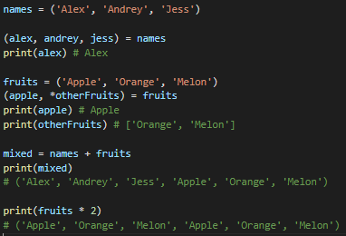
Tuple
A tuple is a collection which is ordered and unchangeable, duplicates is allow.
A tuple similar to a list, but unchangeable. In this way to change a tuple, we may convert it into the list, change and then create a new tuple.
Loop and access to items similar to list.
The Tuple has a unique ability – unpack. That allows us unpack a tuple into different variables
If we don’t know how many arguments – use *args to catch them in the list
Also, a tuple has differences to list in join – you may concatenate them, its returns a new tuple. Also, we may double tuple items just multiple them, as example before it returns a new tuple

Slide 38
Coffee Break

Slide 39
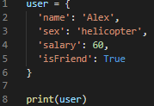
Dictionary
dict is a data structure in python where we may store our data in key: value pair.
dict is a collection which is ordered*, changeable and does not allow duplicates.
As of Python version 3.7, dictionaries are ordered. In Python 3.6 and earlier, dictionaries are unordered.
Dict keys always a strings
Dict value may be different types

Slide 40


Create a dict
To create a dict you may use a common syntax
Create with dict() . There we use a list of tuples that contains key, value
uses dict.fromkeys() . In the first case, our dict doesn’t have values.
Or use a generator. Note! We used a curly brackets

Slide 41
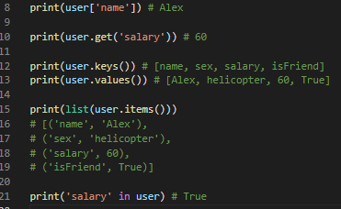
Access data
For access we may use direct method
Also we may do it with .get(str) function
We may separate keys and values with eponymous functions. These functions return to us a list with keys or values
If we want to get keys and values together we may use .items() . It returns a dict_items structure with a list of tuples that contains key, value. To get it as a list you must transform it to the list before.
To check a property in a dict use - in keyword

Slide 42
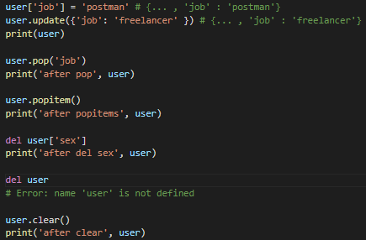

Add | Delete
For add an item to dict use common syntax or .update(dict). You also may use it to change an item
To delete an item we have multiple cases also:
.pop(str)
.popitem() . The method removes the last inserted item (in versions before 3.7, a random item is removed instead)
del keyword. But be careful because if you don’t specify an item it deletes a dict itself.
.clear() . It deletes all property from dict, but not it dict

Slide 43




Loop And Copy
To loop through dict use cycle for. It returns all keys in dict.
To take all values – get it by direct
Also, you can iterate through keys() or values()
To take both key and value - use to the items()
Note! As in lists we may not just define one dict to another like this usercopy = user . It will just be a reference to user, not a real copy of the object
A common way to copy dict use .copy() as we did with lists
Or create a new dict on the old.

Slide 44
Tasks
Create a family.
The family must contains all family members.
Family member – is dict that contains next properties:
Name: string
Age: int
to-do list: string[]
For animals in family use different structure:
Name: string
Age: int
Owners: dict[]
Is Hungry : boolean
There are 4 members of family: Mom Alice 35 y.o. , Dad Garry 33 y.o., Daughter Lora 6 y.o, Dog Maylo 2 y.o.
Mom is going to finish the song, cook dinner, clean the house. Dad is going to work, iron the laundry, change the light bulbs, kiss mom. Daughter is going to play with the dog, eat. The dog was owned to all.
Create a Dictionary.
Create a dictionary with key: English word, value: Translation.
User may put English or translation in input and gets different form. command – translate English -> Translation
User may add new words in your dictionary by command – add English Translation . If a user had a mistake on a number of arguments prints error
Add 5 any words to the initial dictionary
If no word show an error to the user
All commands and words will in lower case

Slide 45

Sets
The set is a collection which is unordered, unindexed, do not allow duplicate values, and have unchangeable items.
Once a set is created, you cannot change its items, but you can add new items.
To access item form set – you can loop through the set items using a for loop,
or ask if a specified value is present in a set, by using the in keyword

Slide 46
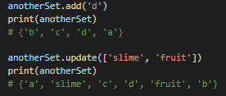
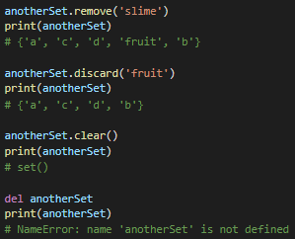
Add/Remove Set Items
To add one item to the set – use add() method. Remember set exclude any duplicate
To add items from another set – use update() method. Actually, update receives any iterable object, so you may put to it array, tuple or dict
To remove item – use remove() or discard() methods. But remember that remove() raise error if item doesn’t exists.
Also you may use pop() , but because a set doesn’t ordered it removes a random item
To remove all items – use clear() method
To delete the set at all – use del keyword

Slide 47
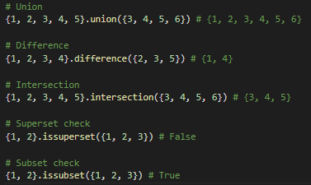
Actions of Set
Just like in mathematics, sets in python have specific methods for joining comparing, and differences. In common all methods change the set on which it was called
For join – use union() method. It’s also as an update() combines the sets.
For Difference – use difference()
For intersection – use intersection()
For checks – use issubset() and issuperset()

Slide 48
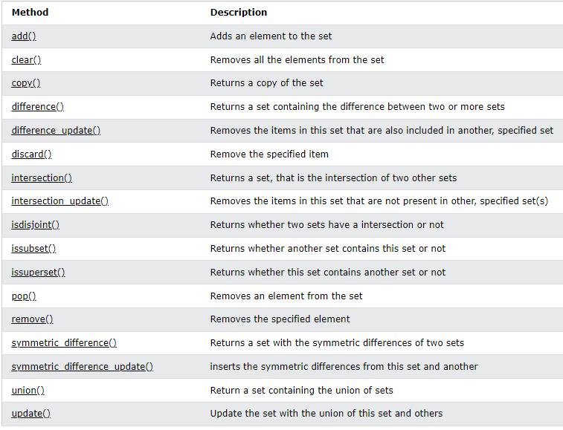
Methods of Set

Slide 49
Tasks
Remove all duplicate from names: list
names = ['Lucy', 'Frank', 'Ann', 'Garry', 'Frank', 'Alex', 'Penny', 'Garry', 'Tom', 'Frank']
Use Set for it
Do it also without set
We have a lists of users who subscribed to magazine and emails.
Emails = ['josh', 'alex', 'lord', 'marry', 'penny', 'dog']
Magazine = ['alex', 'frank', 'harry', 'yourCrash', 'lord']
Find users that subscribed to magazine only
Find users that subscribed to emails only
Find users that subscribed to both magazine and emails

Slide 50



Functions
It reusable predefined block of code, that invokes by function call
Function may have a arguments
… And may returns a value. A value, in this case, it any other type from python. So you may use it for calculation and pass it to another function
Schema –
def NAME (args, *args, **kwargs):
Some code
return

Slide 51
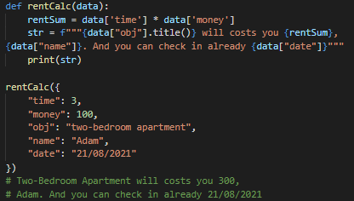
Functions - Arguments
You can use as many arguments as you want, but prefer use a Dictionary for parameters, when them more that 3. And think about decomposition( it much prefers than dict)

Slide 52
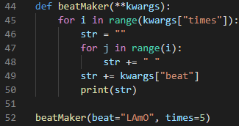
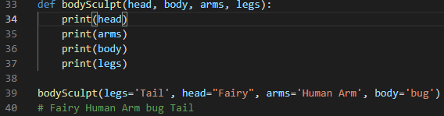


As in example before you can use a Key Arguments or **kwargs – special python syntax for function
OR also use named args
If number of arguments unknown – use a Arbitrary Arguments. ( usually this *ags, but you may define it as you want )
If you plan use default value python provide you a possibility with default value
More about function arguments you may find in docs

Slide 53

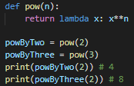
Lambda
A lambda function is a small anonymous function.
A lambda function can take any number of arguments, but can only have one expression.
lambda args: exp
The power of lambda is better shown when you use them as an anonymous function inside another function.
Say you have a function definition that takes one argument, and that argument will be power by an unknown number

Slide 54
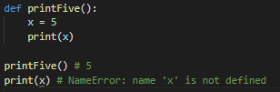
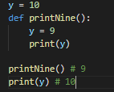
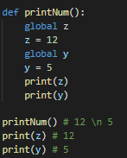
Scope(Closure)
It’s a place where we may use variables and functions. Scope limited by region where the variable is created
A variable created inside a function belongs to the local scope of that function, and can only be used inside that function
A variable created in the main body of the Python code is a global variable and belongs to the global scope. Global variables are available from within any scope, global and local
If you operate with the same variable name inside and outside of a function, Python will treat them as two separate variables.
If you need to create a global variable, but are stuck in the local scope, you can use the global keyword.
Also, use the global keyword if you want to make a change to a global variable inside a function
Local Scope
Global Scope

Slide 55

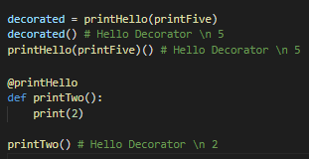
Decorators
Decorators are design patterns, that alter the functionality of functions without functions changes themselves. Think about it like a wrapper for a present.
The decorator takes a function as an argument and returns a new function with modificated functionality.
Simplest schema of a decorator:
def decorator(func):
def newF():
do something
func()
return newF
Also you need remember about returned value of original function.
To using a decorator we have few ways:
Create an instance of the decorated function
Add decorator to defining a function with keyword @ ( Note! Every time you call a function call will be with decorator)

Slide 56

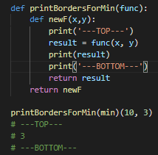
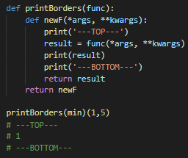
Passing arguments to decorator
You may pass any number of arguments to the decorator. There are two ways:
Pass all specificated arguments of the function to the returned function (But it decreases the universality of the decorator)
Do it universal and pass arbitrary arguments and keys arguments
Note! We handle the return of the original function, so it may work as before

Slide 57
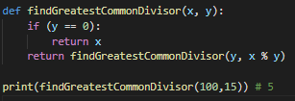
Recursion
It’s not the specific topic of python, but a powerful technique of programming. The main idea of it’s a returns function itself as many times as it needed
First, define the base case. It must return value if the passed argument match the condition
Then return a function with modified arguments
Be careful with these conditions because it may start an infinite loop
Return function with modified arguments
Base Case

Slide 58
Tasks
Write a function that returns a Average of arguments
We don’t know how many arguments we will have
Write a decorator that prints:
Arguments of function – args and kwargs
Return from function
Use it with @
Write a Fibonacci number function
A Fibonacci sequence is the integer sequence of 0, 1, 1, 2, 3, 5, 8....
The first two terms are 0 and 1. All other terms are obtained by adding the preceding two terms. This means to say the nth term is the sum of (n-1)^{th} and (n-2)^{th} term.
Args – (n: Int)
Returns – n Fibonacci number
Example – 2 -> 1 ; 4 -> 2; 7 -> 8

Slide 59
Tasks
You are skeleton lord. And you need an army. Create a program with a function that creates a skeleton with given args. Also you need a system to manage them: add, delete, find and send to defeat hero.
Start in skeletons_start.py
You have an army: list
Every skeleton has:
name: string
id: int – unique number
health: int
damage: int
You may provide all characteristics except id, but required always the only name. Other defaults it is health – 20 , damage – 10. Manage id as you want
The hero will be provided
All actions must be printed
All actions are taken from the input. Name command as you want
Before the program starts, show a user all commands
Add – adds skeleton to the army
Find – return skeleton by id from your army, but not delete them. Must return 0 if skeleton not found
Delete – deletes skeleton by id from your army. Must return 1 if success or 0 if failed
Send to defeat – takes skeleton, then skeleton and hero are fighting.
They fights while one of them doesn’t die. Every cycle the hero hit the skeleton when the skeleton hit the hero.
If skeleton health <= 0 print ‘SKELETON_NAME defeated’ and delete him from the army.
If hero health <= 0 , program prints ‘Hero defeated’ and program out.
Statuses of hero and skeleton must printed

Slide 60
Coffee Break

Slide 61



Exceptions
You may notice that sometimes our program failed with errors. In python, errors are named exceptions, and we may handle them.
Before we learn how to handle an error, let’s learn how we may do a custom error
To throw (or raise) an exception, use the raise keyword.
You can define what kind of error to raise, and the text to print to the user
All errors types you may see here

Slide 62
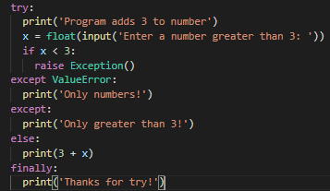
Error handling
There are 4 blocks for doing it - try, except, else and finally
First, wrap code block with a potential error in try
Then add an except block that catches an error. You may add so many except blocks as you want.
If you want to do something when your block of code doesn’t have errors – add else block
If you want to do something every time, no matter error was or not – add finally
Note! Don’t use try without except
Full schema –
try:
…your code
except [Error Type]:
…error handling
else:
… only when there is no errors
finally:
…Every time

Slide 63
Tasks
Do you remember a BMI calculator? Time to protect it from bad users who try to put a string in inputs. And of course, let's do our program better.
Now the program has code duplicates, reduce them with functions
Add error handling to user inputs
The program should ask the user to enter the data until the user enters the correct data
If the first number is correct remember it and don’t ask again

Slide 64

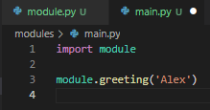
Modules
Right now our programs are small, but if a program will have 10000+ strings of code? How we may fast find and change code in this case? For that case, we may separate code on different files or modules. A module is a library, and many python tools are named libraries.
Let’s create our first module! First, create two files – module.py and main.py
Add a function to module.py
Then use import keyword to import our module
And finally call function by <moduleName>.<objectName>
Superb!
Note! We used to <objectName> , not only a function may be imported
To show all exports from module use dir()

Slide 65



Import
There are many ways how you may use import:
Use it as we do it in the previous example
You may rename a module
Use from keyword to import all
Or use from keyword to import a single object. In that case, you reduce the memory that the module requires.
Note! If we use from we may use the function directly without dot notation. But be careful because in this way function with the same name will be rewritten

Slide 66
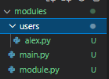

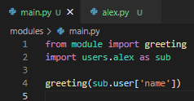
Import Order
Of course, python have many built-in modules, like math, and other downloaded modules. So how python may find exactly our module?
First, we need to know the order of python modules:
Standard library imports
Related third party imports
Local application/library specific imports
For our modules python searches in the same folder.
For subfolders, we must use the submodule import

Slide 67
Tasks
Returns to our skeletons program. Now you need to refactor it.
Separate all functions from the program into : skeletons, base, additional and userInteraction files
Skeletons must contain only initial status and program loop
Base must contain actions – create, add, delete, find, sendToHero
UserInteraction must contain all functions from the main loop
Additional contains all other functions

Slide 68

Random Module
Random provides you a random number generator with different generator functions. Here are some helpful of them:
random() – return a random value between 0 and 1
randint(A, B) – return int value between A and B
choice(sequence) – return a random value from the sequence. The sequence must have at last 1 value
shuffle(sequence) – shuffles the sequence. None return!
sample(sequence, length) – return a random sequence with a given length from the original sequence

Slide 69
Tasks
Our skeletons program is boring and predictable in battle. Let’s do it more fun
Damage of skeletons is a random number between 10 and 30
Health is also a random number between 1 and 30 multiplied by 2.35 and rounded to int
Add a function that send to hero a random skeleton

Slide 70

Time Module
Some function in time module takes a time.struct_time as argument. Object time.struct_time contains:
This module to work with time in seconds since 1 January 1970 (UTC).
time() – get time since 1 January 1970.
ctime(seconds) – get time since given seconds
sleep(seconds) – stop the current program on given seconds
gmtime(seconds) – takes seconds and returns struct_time
mktime(struct_time or tuple) – takes struct_time or tuple with 9 value according struct_time. Returns a seconds since 1 January 1970
asctime(struct_time or tuple) – returns a date string

Slide 71

Time module - examples

Slide 72


Datetime Module
This module is for works with a custom date. It’s different from time and provides you comfortable methods to work with dates, for a case, math operation with a date. Basic usage is working with an instance of datetime, but also the module has a date, time and other classes. We will work only with datetime, because it includes both date and time.
datetime.now() – this method you may use without creation datetime. It returns a current date. And creates instance of datetime
datetime(year, month, day, [hour], [minute], [second], [millisecond]) – basic instance of datetime requires only 3 arguments, but you may provide an additional arguments.
datetime has many properties and functions, there are some of them – time(), date(), weekday(), year, month, day, hour, minute, second, millisecond

Slide 73



Datetime Operations
Besides class datetime the module has class timedelta. This reflects time changes.
timedelta([weeks],[days], [hours], [minutes], [seconds], [milliseconds]) - create a timedelta instance. You may provide a additional data, but may create without arguments at all
But there is another way to create timedelta. When we try to add or subtract datetime with datetime or timedelta it return to us timedelta object

Slide 74
Tasks
Write a benchmark decorator that counts how many time a function uses for calculation
Write a program that counts how many days the user lives.
Ask from user a day, month, and year
Print how many days the user lives.
User want to get a random date from the past.
Write a program that returns to the user a random date between 1 and 2021 years.
A date and month also a random

Slide 75
Files
File handling is an important part of any programming language. In this part, we will work with txt files, but it is similar to other types of files.
The main function to work with files is open(). It takes a filename, mode, and buffering.
Filename – is the path to file or file itself if it placed in the same directory
Some of mode:
'r' - reading mode. The default. It allows you only to read the file, not to modify it. When using this mode the file must exist.
'w' - writing mode. It will create a new file if it does not exist, otherwise will erase the file and allow you to write to it.
'a' - append mode. It will write data to the end of the file. It does not erase the file, and the file must exist for this mode.
'r+' - reading mode plus writing mode at the same time. This allows you to read and write into files at the same time without having to use r and w.
'w+' - writing and reading mode. The exact same as r+ but if the file does not exist, a new one is made. Otherwise, the file is overwritten
'a+' - appending and reading mode. Similar to w+ as it will create a new file if the file does not exist. Otherwise, the file pointer is at the end of the file if it exists.

Slide 76






Read a files
To read a file – use ‘r’ mode. In this mode you have some helpful functions:
read([int]) – returns all content of file.
readline([int]) – returns a line on every call.
readlines([int]) – return a array of lines.
You may notice that we don’t put an argument in this function. If you do this, you may specify how many contents will be read. Read and Readline counts symbols, in that case, the next call returns a remainder part. Readlines count by lines.
Also you may loop through file line by line.
Note! Here we don’t handle error that occur if file doesn’t exists. We fix it in preferable example.
Note! Always close() the file. It is a good practice

Slide 77


Write a Files
To write a file use – ‘w’ or ‘a’ mode. The difference between them is ‘w’ creates the file if this doesn’t exist or rewrites the current file. ‘a’ doesn’t rewrite file, only adds to the end and raise Exception if file not exists
write() – main method to write to the file

Slide 78
Tasks
Write a program that counts symbols words and letters in a given file
User inputs a filename
The file always must be .txt . To check filename use file.name property
Program prints words and letters and finish
Write the Budget program. It must counts a budget by month.
User inputs a filename
The program counts a monthly sum by values in file
Value = NameValue: (+/-)sum. Example – Food: -100
Each value is a line
Program write a calculated sum in ‘output.txt’ in format – filename: sum
Filename and structure are always correct

Slide 79
Coffee Break

Slide 80
Object-oriented programming (OOP)
Python is an object-oriented programming language. Almost everything in Python is an object, with its properties(attributes) and methods.
Class is the basic structure of an object. You may think about object as a blueprint of real things like a Car, Airport, or Human.
Single objects created by Class is named instance. An example, A Car that has a brand, model, max speed, and may ride, stop, and show a fuel level, and The instance Ford Mustang with a max speed equals 200 mph.
There are 3 main concepts of OOP :
Encapsulation
Inheritance
Polymorphism

Slide 81



Create Class
Before we start learning concepts, we need to know how to create a Class and work with it.
Use syntax –
class <className>:
…class description
Then we add some properties
Add methods. Note that we declare an argument, but do not provide it when we call a method.
Now you can create an instance of Class. But it does not work as we want, because is a stupid class.
And it’s not all. For real Class, we need a constructor. For this python provide a private method __init__ that calls every time when instance will create

Slide 82


__init__
To create a constructor we must define a __init__ into our Class. It takes an argument that refers to the created instance itself, historically in python, it is named – self
Also, __init__ may takes any arguments that you want to provide. This arguments will be a properties(attributes) of the instance.
You may think about a constructor as a factory that builds an instance with a given property

Slide 83

Add property
We added property in the constructor. But class may have default properties
These properties are the same for all instances
All property may be rewritten by the user of the class.

Slide 84

Add methods
In our first class, we added a method that works but works without class. It was like a different function with a strange argument. Let’s create a real method!
First, we need to define a function in the class.
Second, add arguments. For all functions in the class python automatically send a self reference. In our class, we named it n , but it’s still a reference to the instance. In this case, for all methods of class the first or even single arguments - self
Then we may use into this methods all property of class and other methods
Cool! Our first real class is done

Slide 85

__str__
This is a python private method that calls every time when object transforms to string.
You may define into your class e for better performance
Note! __str__ must return a string

Slide 86
Tasks
Create a class Car that has a brand, model, maxSpeed, currentSpeed, isRide properties. And also, has a start, stop, setSpeed methods.
Start() – must starts car- set isRide to True, and set a default currentSpeed. If it is already started ignore the call and handle Exception
Stop() – similar with start() but reverse actions.
setSpeed() – must try to set speed but no more than maxSpeed.

Slide 87


Encapsulation
Did you notice how easy to broke our class? For example, in the last task, we may change the speed directly without our cool method.
Encapsulation is a concept that say us how we may fix it.
We must hide all inner properties from direct access. In python, we may use two ways:
Add 'virtual attributes’ - __property
Create a getter and setter for property
Use @property decorator to define getter
Use @<propertyName>.setter to define setter
But Encapsulation is not only about hiding. It’s about collecting all used in class property and methods together. In that way, we may be confident in the safety of our class

Slide 88




Inheritance
You create a zoo program , and of course, you need many classes of animals – dogs, bears, parrots. How much code duplication you will need?
Inheritance is a concept that represent show we may reduce code and create a clear structure of the program. Right now, we have Class of Animal. Is dog and parrot also animals in real life? So we may Inherit all property and methods to our new Class!
To do it in python:
Add to class a parent
Use a parent constructor with super() in the child class constructor. Note! It always must be first in child __init__ and we need to call __init__ on parent
If you don’t want to change arguments you may doesn’t define __init__ in child class

Slide 89




Polymorphism
We have a class of bird, and child class – parrot, and now we need to add a raven. But there is a problem, parrots and ravens have different flying. How we may handle the different behavior?
Polymorphism is a concept that tells us – a child may extend parent behavior. Polymorphism is the ability of an object to take on many forms.
To do it – just override a parent method in child class
You also may use an original function from a parent with super()

Slide 90
Tasks
Rewrite your Car Class according to concepts
Write a program for Airline reserving.
Program user is a manager
Airport contains as many airplanes as manager set while init program
Manager may add users, reserving seats, cancel reserving, ban users, see all info about airplanes or single airplane
Do it with only classes

Slide 91
Coffee Break

Slide 92
Final Trials
Your current task is pretty simple – Just finish All
https://www.codewars.com/kata/52fba66badcd10859f00097e
https://www.codewars.com/kata/5667e8f4e3f572a8f2000039
https://www.codewars.com/kata/554b4ac871d6813a03000035
https://www.codewars.com/kata/546e2562b03326a88e000020
https://www.codewars.com/kata/523f5d21c841566fde000009
https://www.codewars.com/kata/5526fc09a1bbd946250002dc
https://www.codewars.com/kata/54b42f9314d9229fd6000d9c
https://www.codewars.com/kata/54da539698b8a2ad76000228
https://www.codewars.com/kata/5682e646d5eddc1e21000017
https://www.codewars.com/kata/5682e72eb7354b2f39000021
https://www.codewars.com/kata/5682e809386707366d000024
https://www.codewars.com/kata/5682e545fb263ecf7b000069

